Slide 1
Comparison of ES50/100 CONUS Maps
Dec 15, 2022
Questions to sformel@usgs.gov

Slide 2
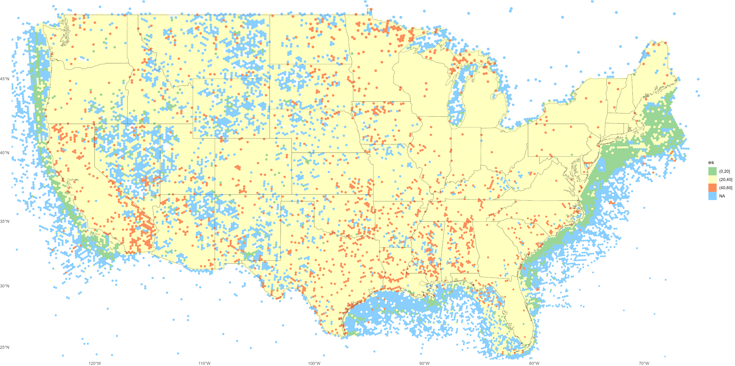
2010s, res 5. ES50 GBIF + OBIS

Slide 3
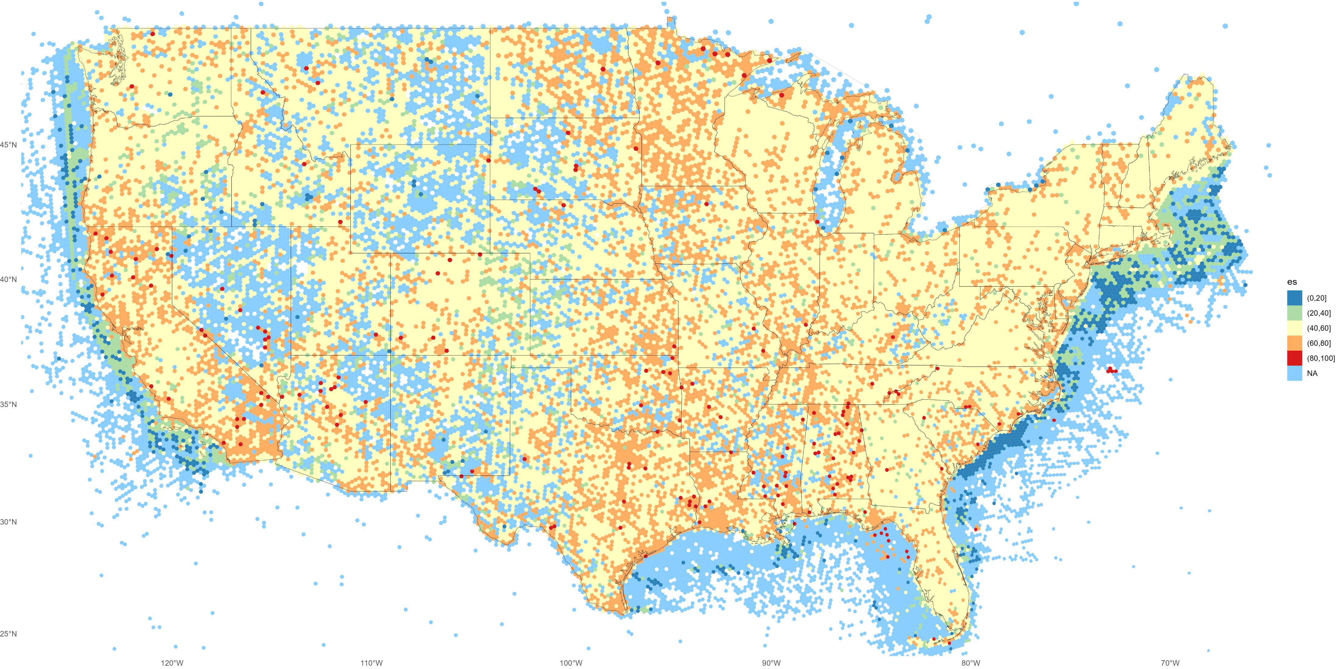
2010s, res 5. ES100 GBIF only

Slide 4

2010s, res 5. ES100 GBIF + OBIS

Slide 5
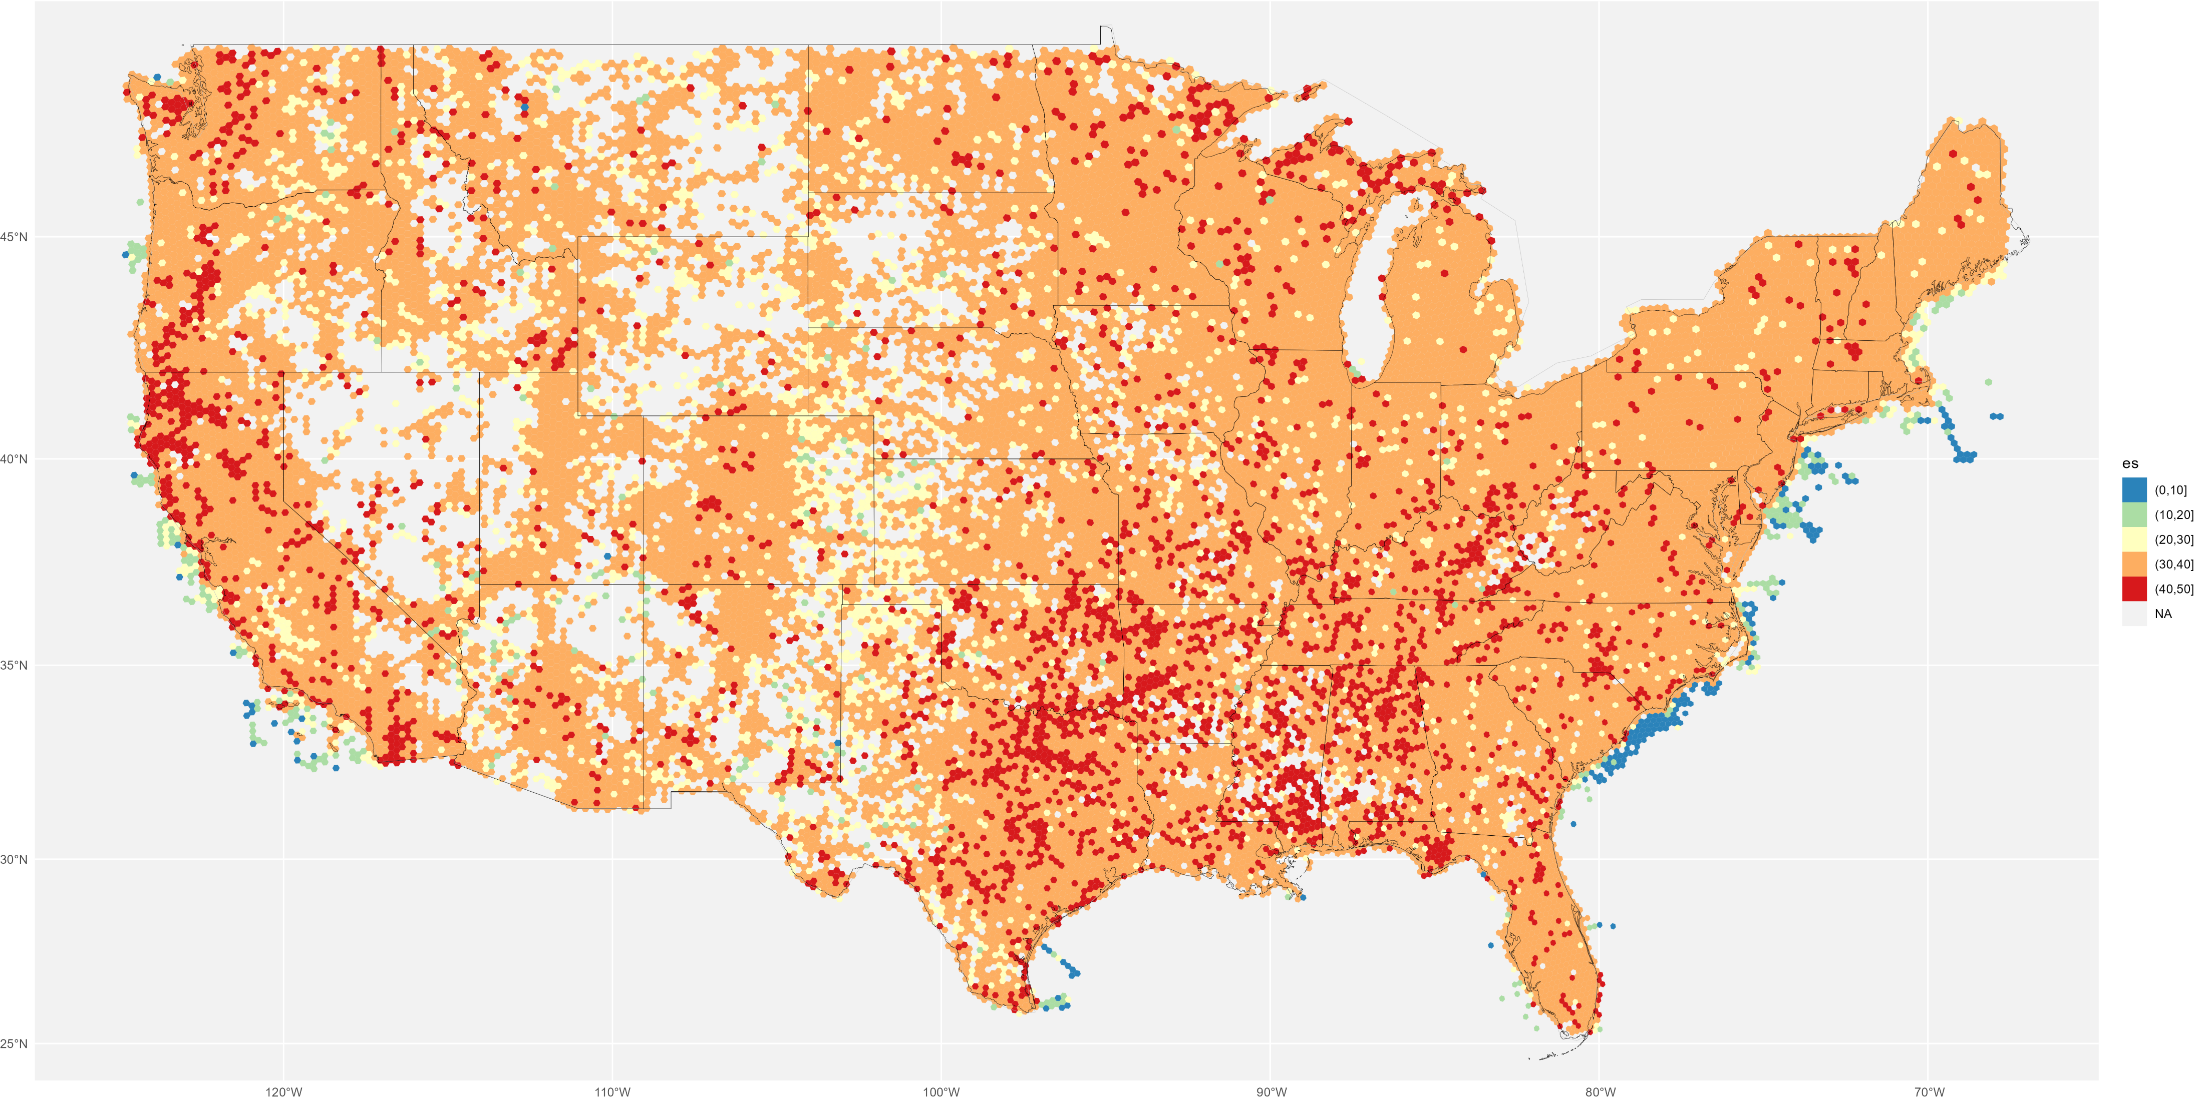
2010s, res 5. ES50 GBIF only (clipped to CONUS bounding box)

